Slide 1
Spotify Song Recommendation System
By:-
Tejas Dayanand
Kalavathi Pannayyagaru

Slide 2
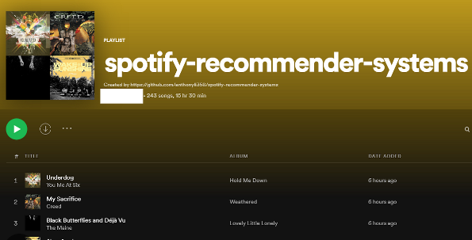

Slide 3
AGENDA
Introduction & Business Objective
How Spotify's Recommendation System Works
Key Components of a Spotify Song Recommendation System
Spotify Data Analysis
Text Cleaning & Preprocessing
Vectorization & Cosing Similarity
Recommendation Algorithm And Function
Streamlit Application[Recommendation System]

Slide 4
Introduction & business Objective:-
A Spotify song recommendation system uses algorithms to suggest music to users based on their listening habits, preferences, and other factors.
The system aims to enhance the user's experience by presenting them with personalized music recommendations that match their tastes

Slide 5
How Spotify's Recommendation System Works
Collaborative Filtering: This method recommends songs to a user based on the listening habits of other users with similar tastes. If two users have a similar playlist or listening history, the system may suggest songs that one user has listened to but the other hasn't.
Content-Based Filtering: This technique recommends songs based on the characteristics of the songs the user has already liked. It uses metadata such as genre, artist, tempo, key, and even more specific features like danceability and acousticness.
Natural Language Processing (NLP): Spotify uses NLP to analyze text data from various sources, like blogs, articles, and reviews, to determine how songs are discussed and to identify trends or clusters.

Slide 6
Key Components of a Spotify Song Recommendation System
User Profile: Includes data on user preferences, such as favorite genres, frequently listened-to songs, and explicit likes or dislikes.
Item Profile: Contains metadata and extracted audio features for each song, including genre, artist, tempo, mood, and more.
Interaction Data: Captures user behavior, such as play counts, skips, likes, playlist additions, and even search queries.
Recommendation Algorithm: The machine learning model that takes user and item profiles, along with interaction data, to generate a list of recommended songs.

Slide 7
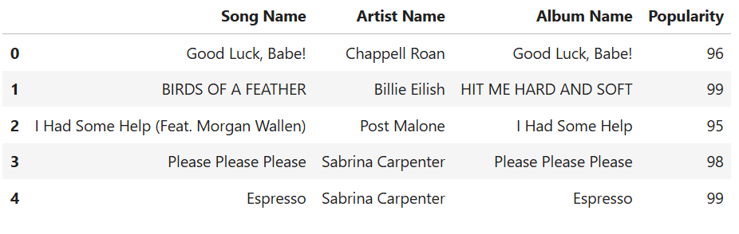
Spotify Data Analysis

Slide 8
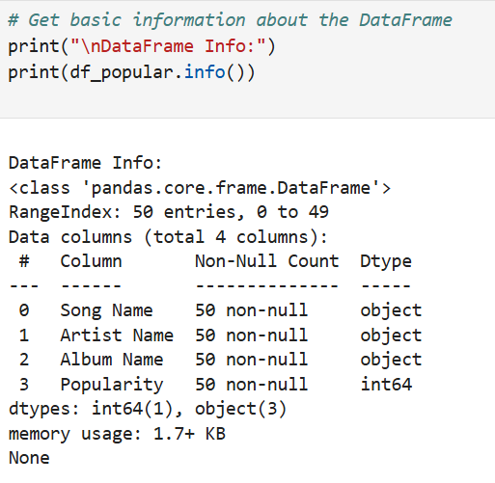
Features Of Our Dataset

Slide 9
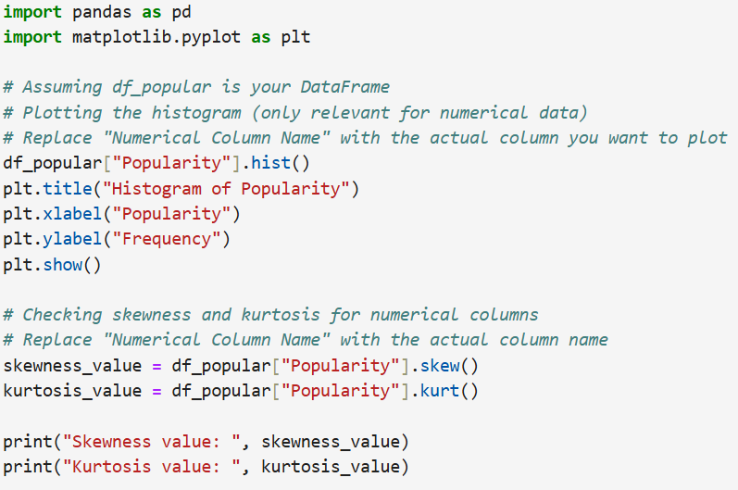
Visualizing Features of Our Dataset

Slide 10
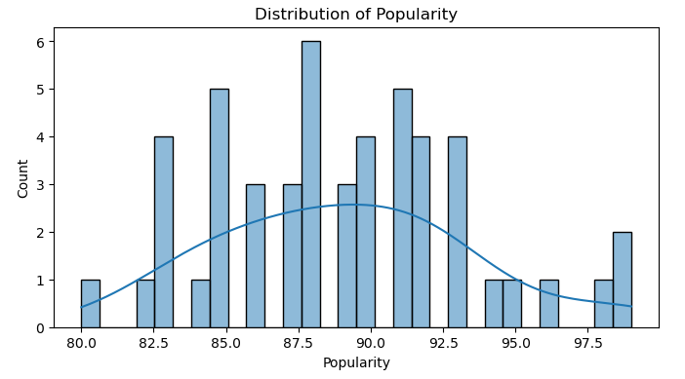
How Popularity Of Songs Are Varying

Slide 11
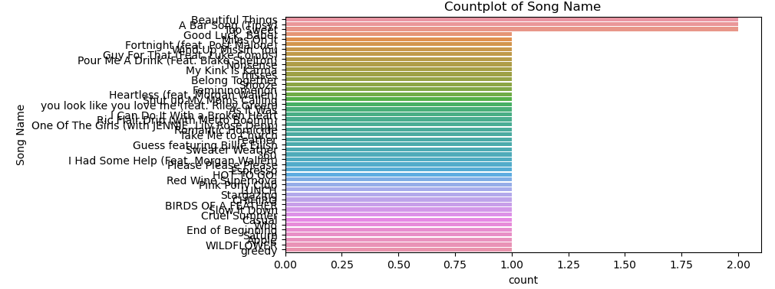
Visualizing variety of songs

Slide 12
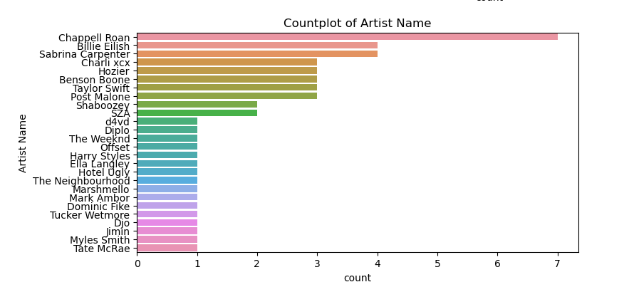
Visualilzing Artists

Slide 13
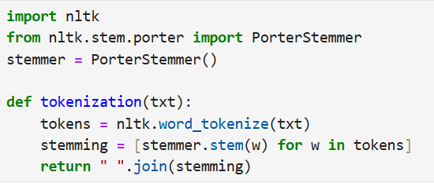
Text Cleaning & Preprocessing

Slide 14

Vectorization & Cosing Similarity
1. Vectorization
Vectorization is the process of converting objects, such as words or songs, into vectors (arrays of numbers) that can be used in mathematical computations. In the context of a song recommendation system, each song can be represented as a vector of features.
2. Cosine Similarity
Cosine similarity is a metric used to measure how similar two vectors are, regardless of their magnitude. It is particularly useful when comparing high-dimensional vectors, like song features, because it focuses on the direction of the vectors rather than their length.

Slide 15
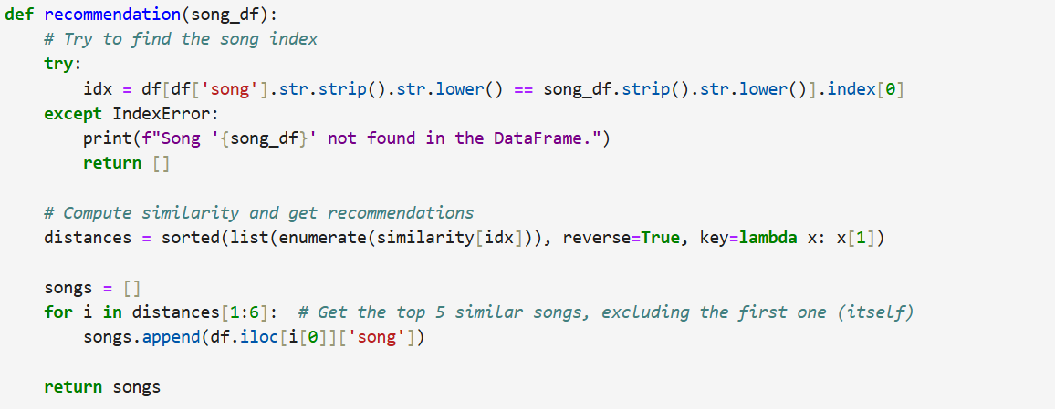
Recommendation Function[Content Based Filtering]

Slide 16
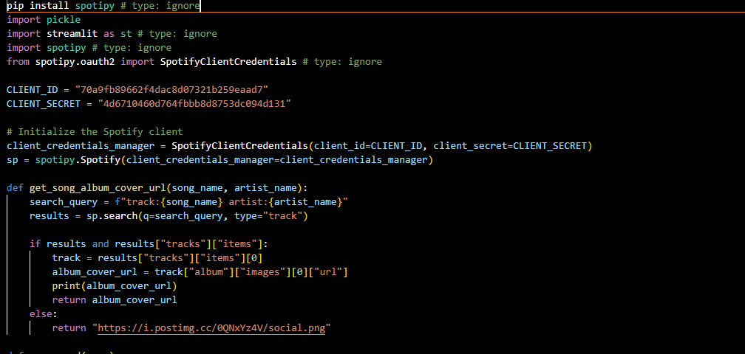
Streamlit Web Application

Slide 17
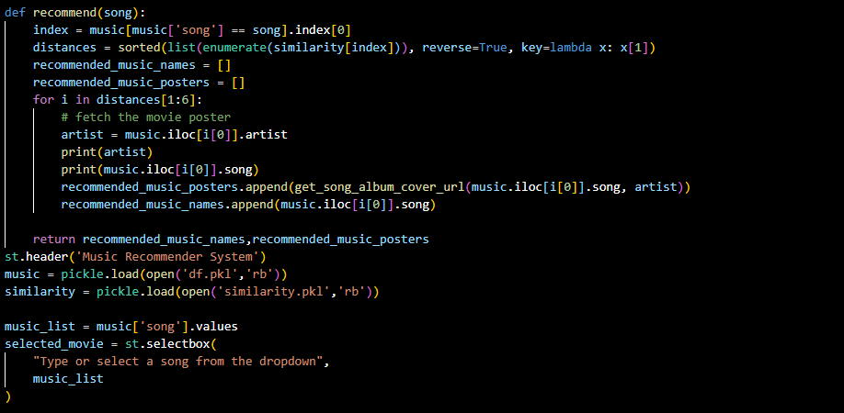

Slide 18
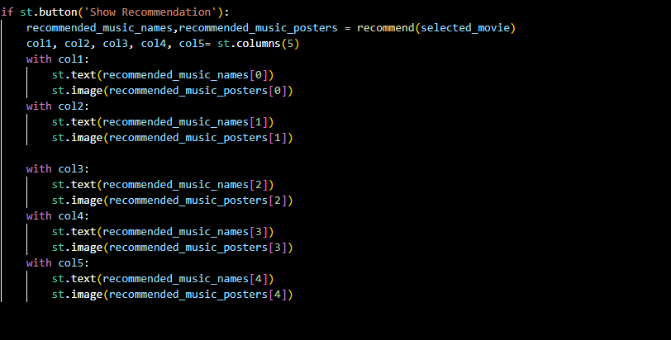

Slide 19
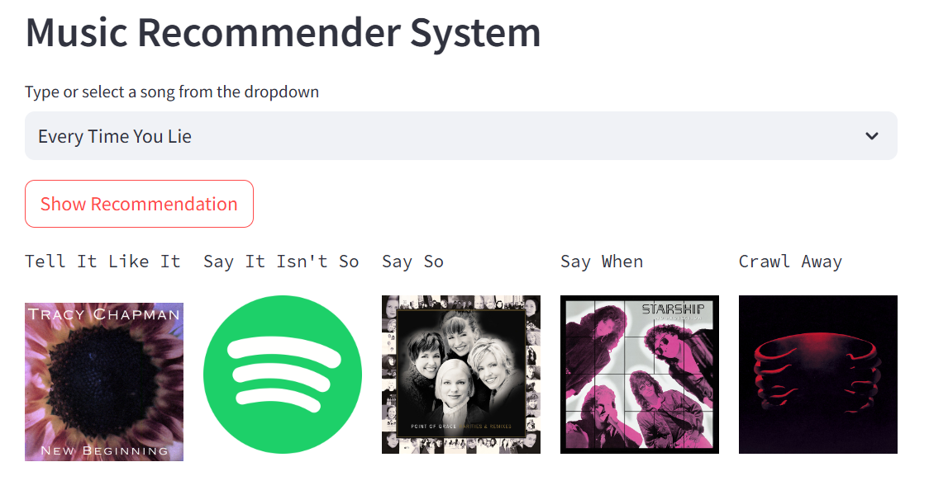
Recommendation System

Slide 20
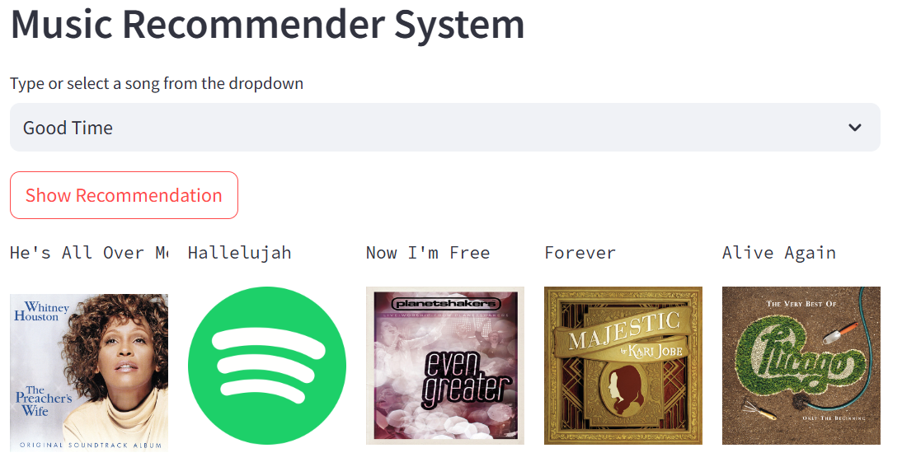

Slide 21
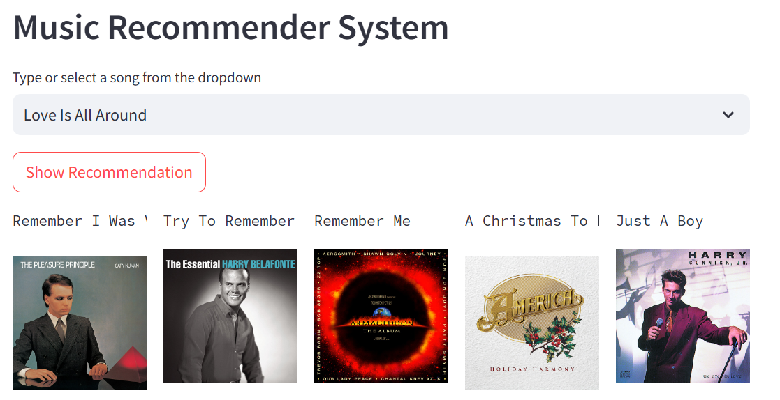

Slide 22
Conclusion
The Spotify Song Recommendation System is an excellent example of how modern technology and machine learning can be used to enhance user experience by providing personalized music suggestions. By analyzing user data and leveraging various algorithms, Spotify has developed a system that understands and predicts user preferences, making it easier for users to discover new music that aligns with their tastes.

Slide 23


